Slide 1
Clothing E-Commerce Website

Slide 2
Overview
Introduction
Technology
Analysis
System Design
Database
Demo

Slide 3
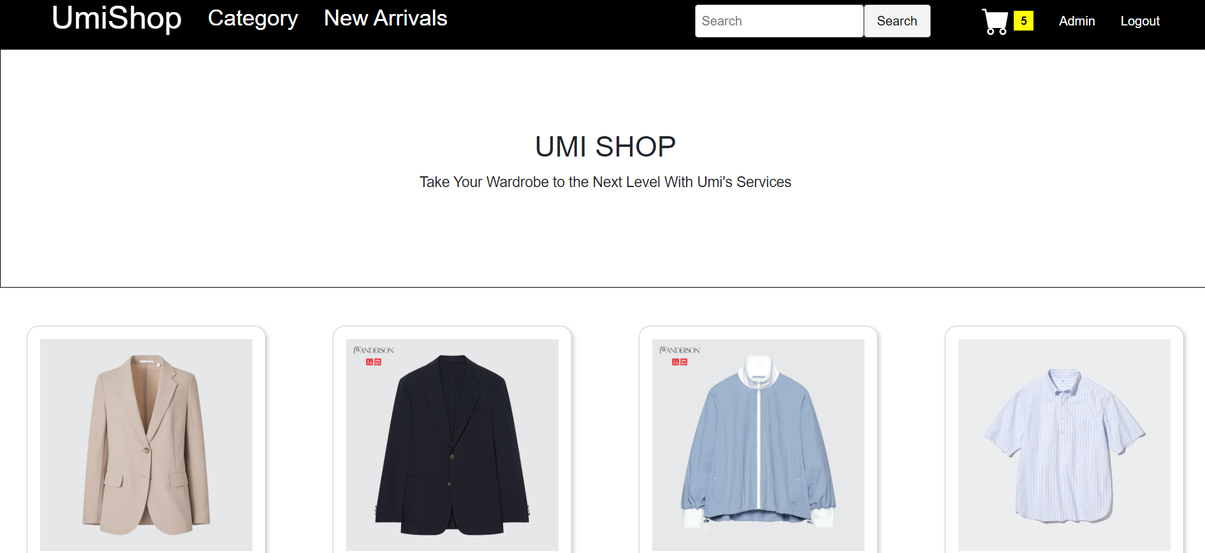
Introduction

Slide 4


Technology

Slide 5


Technology

Slide 6
Analysis
Req.ID | Requirement Name
001 | Register and login an account
002 | Product Catalog
003 | Shopping Cart
004 | Payment Gateways
005 | Order Management
006 | Item Search Function
Functional Requirements

Slide 7
Analysis
Req.ID | Requirement Name
008 | Performance
009 | Security
010 | Usability
011 | Reliability
012 | Scalability
Non-Functional Requirements

Slide 8
Features
Authentication
Search
Product Catalog
Cart & Product Browse
Admin Dashboards
CRUD

Slide 9
System Design

Slide 10

Database

Slide 11
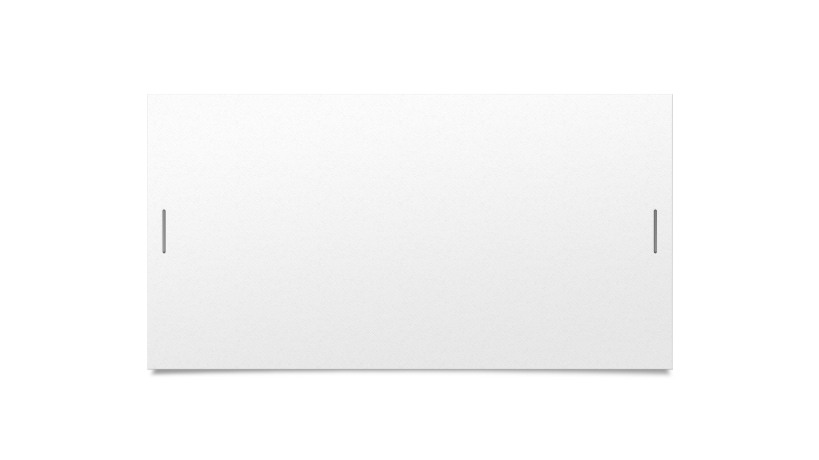

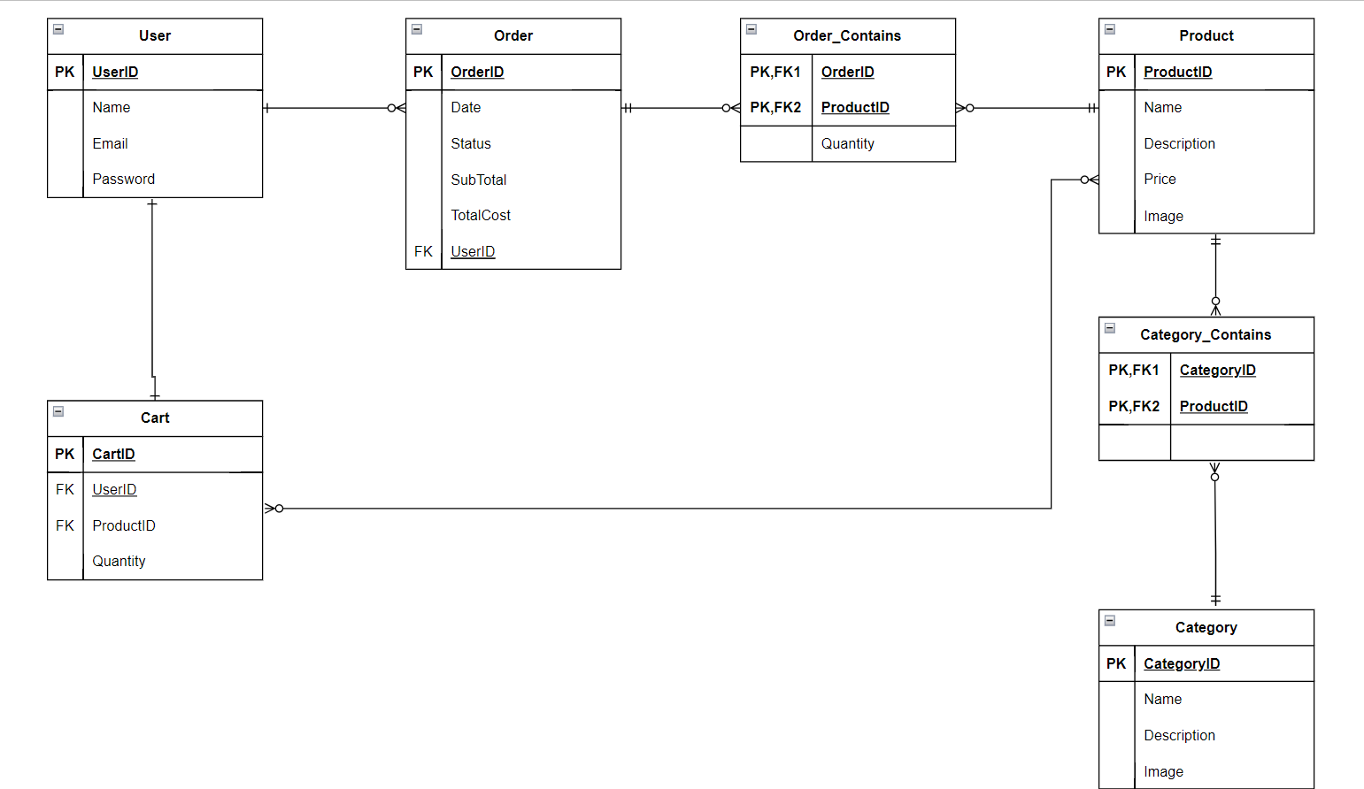



Slide 12
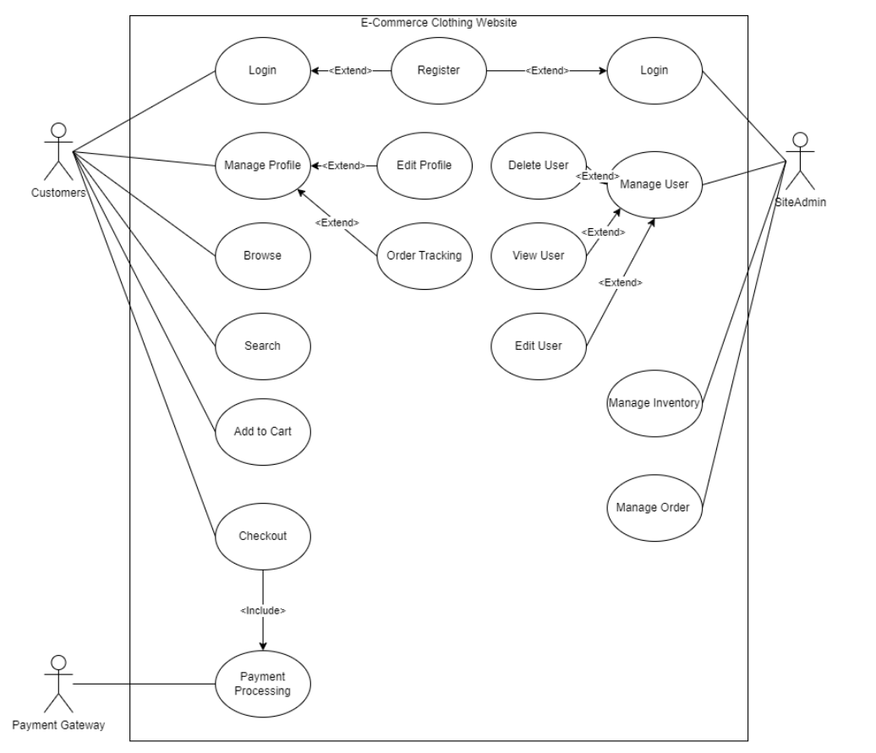
Use Case Diagram

Slide 13
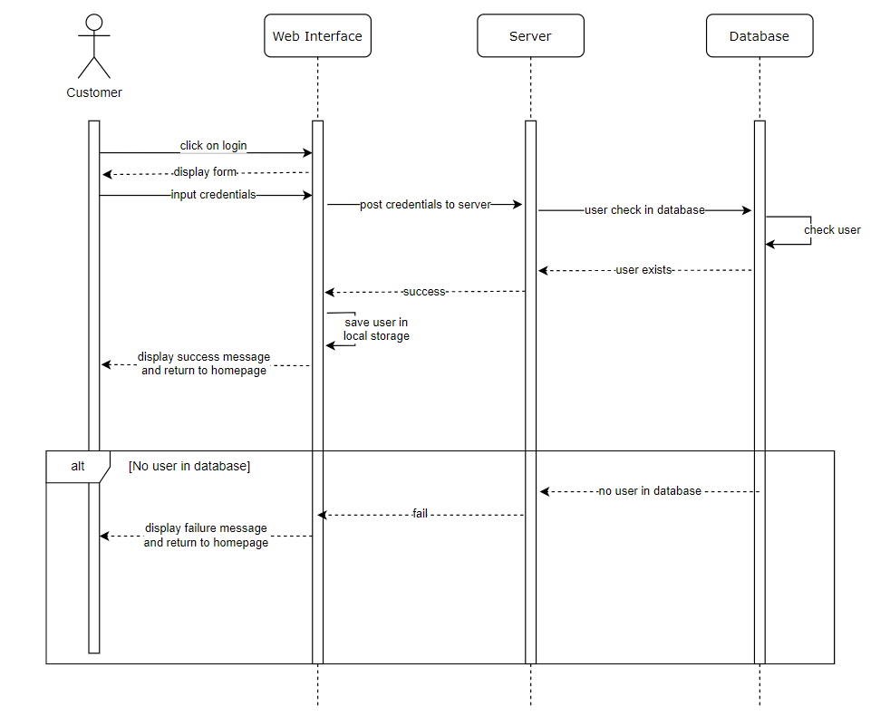
Sequence Diagram

Slide 14
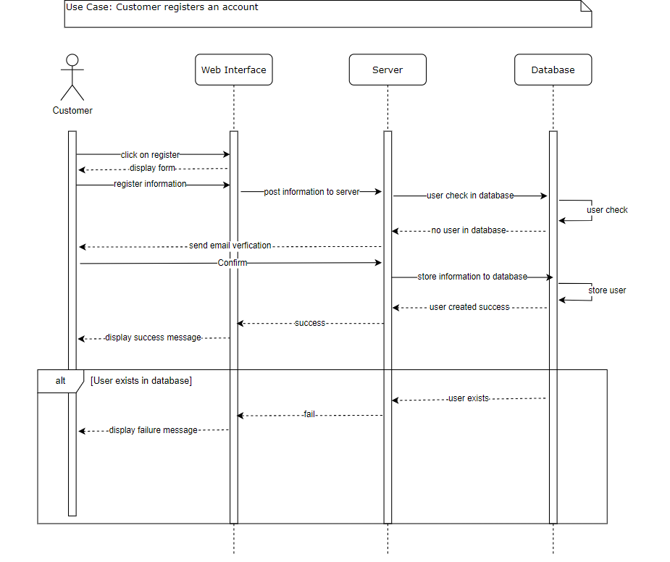
Sequence Diagram

Slide 15
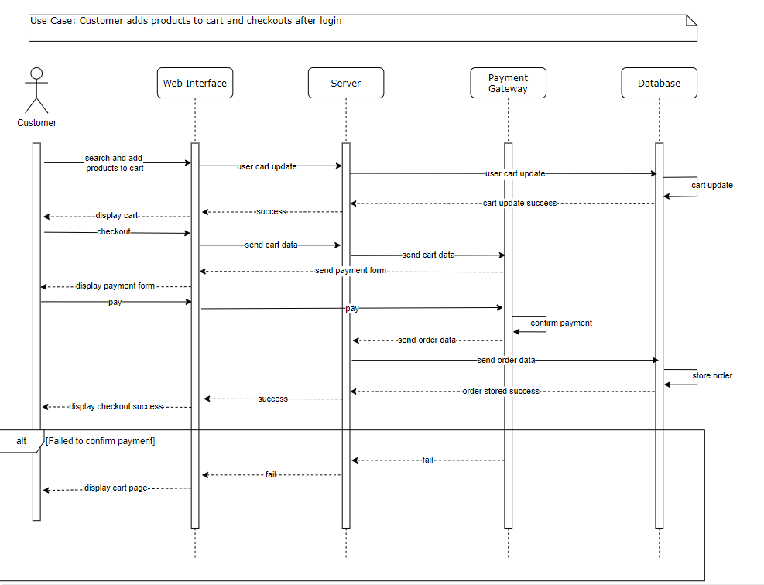
Sequence Diagram

Slide 16
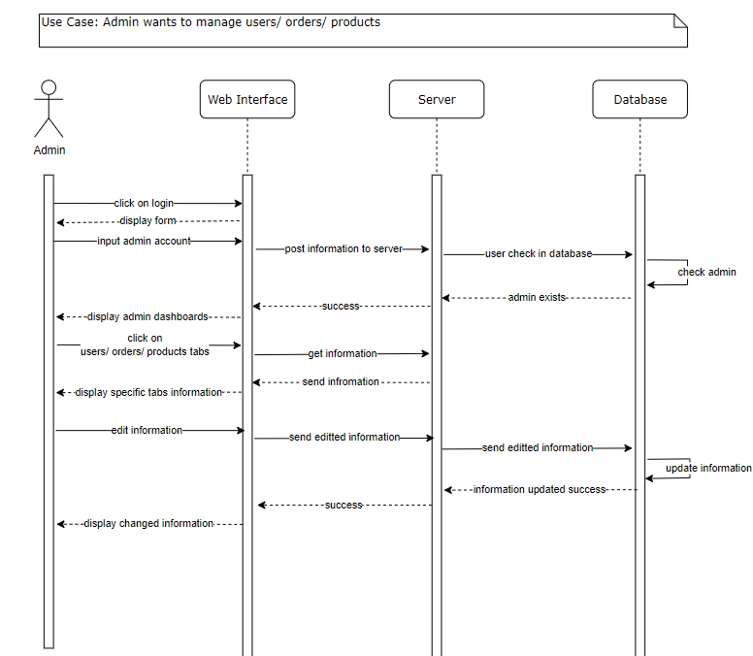
Sequence Diagram

Slide 17
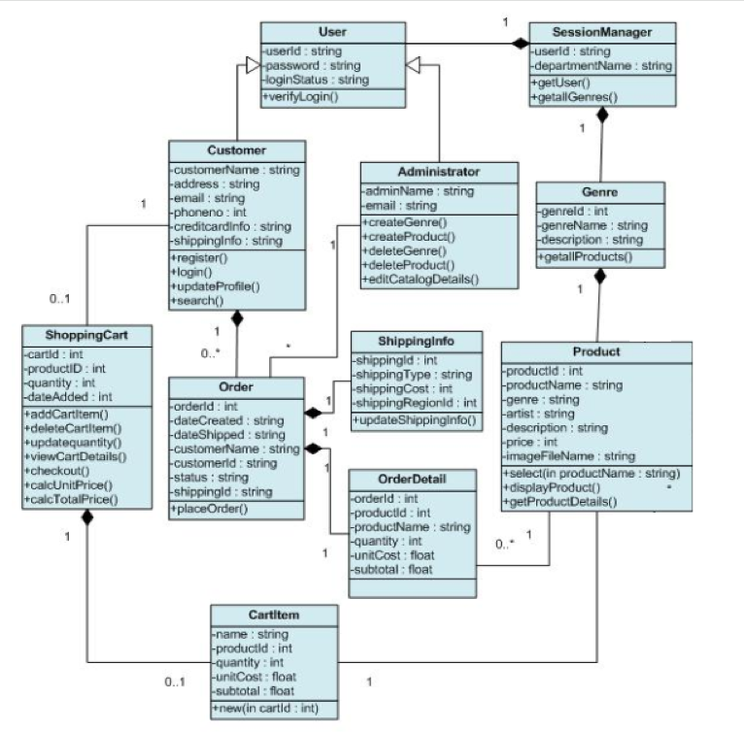
Class Diagram

Slide 18
Demo

Slide 19
Future Improvements
Better UI designs
Better Product Information
Improve Authentication

Slide 20
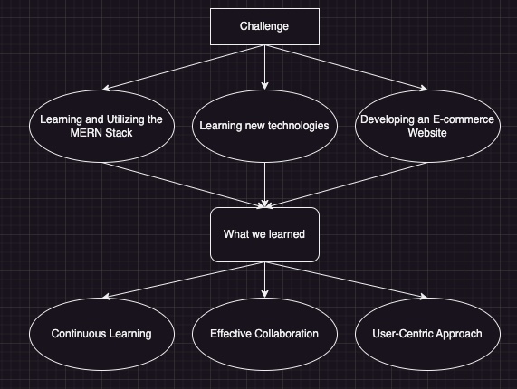
Conclusion

Slide 21

Thank you for listening.
Is there any question?

